Slide 1
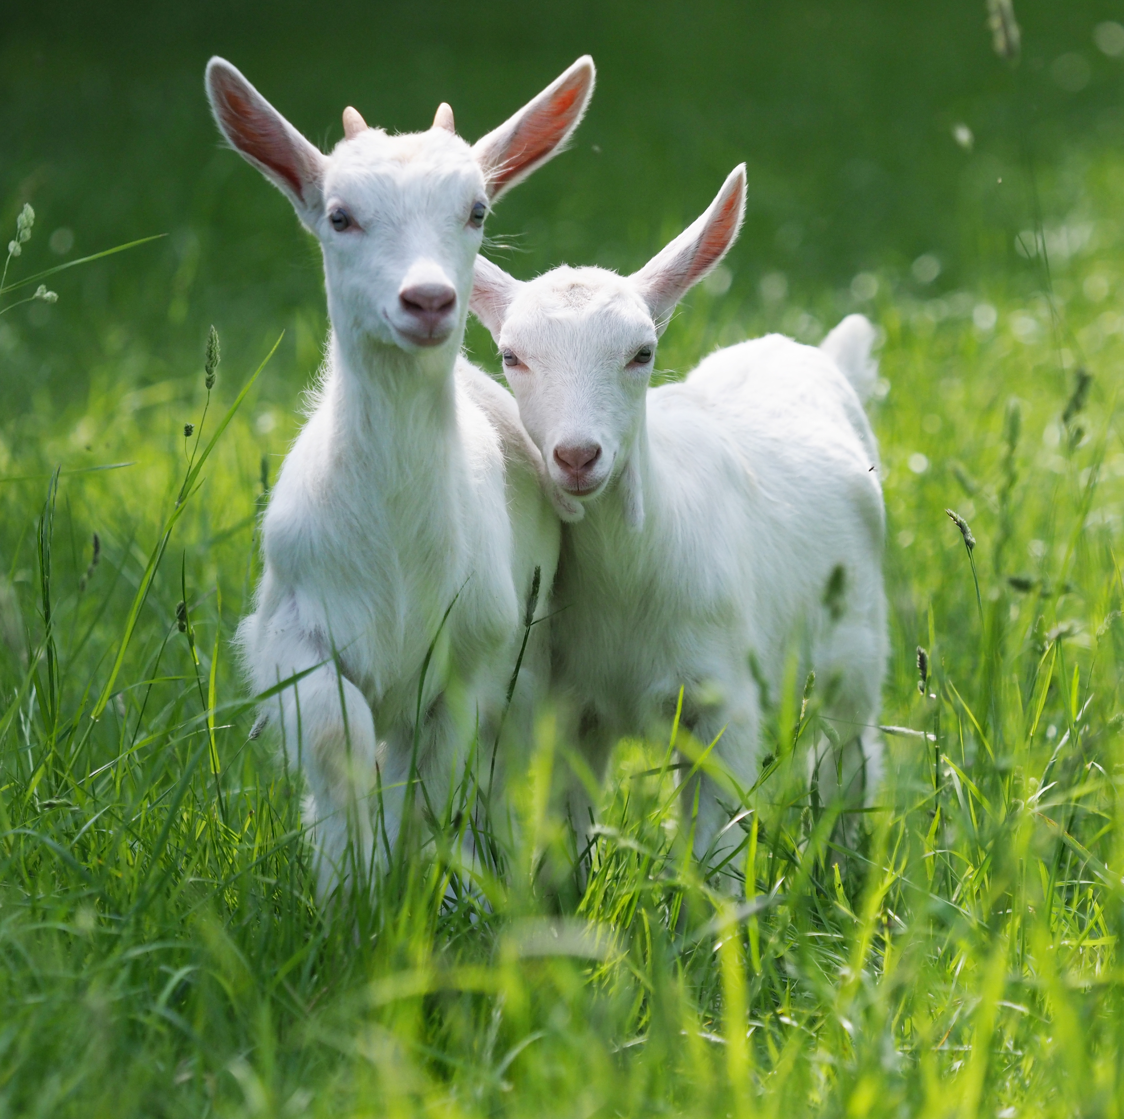
Bulk RNAseq data analysis Ovis Aries

Slide 2

Bulk RNAseq data analysis pipeline
Read Alignment
STAR aligner: To align reads on OviAri4 genome
Gene Counts
featureCounts: To count reads for each gene
Differential Expression
DESeq2: For DGE analysis between untreated and treated samples
STRING Analysis
PPI Network: Supplying with top 500 DGEs to check for interactions and pathways
Quality
Check
FastQC: Sequencing quality assessment

Slide 3
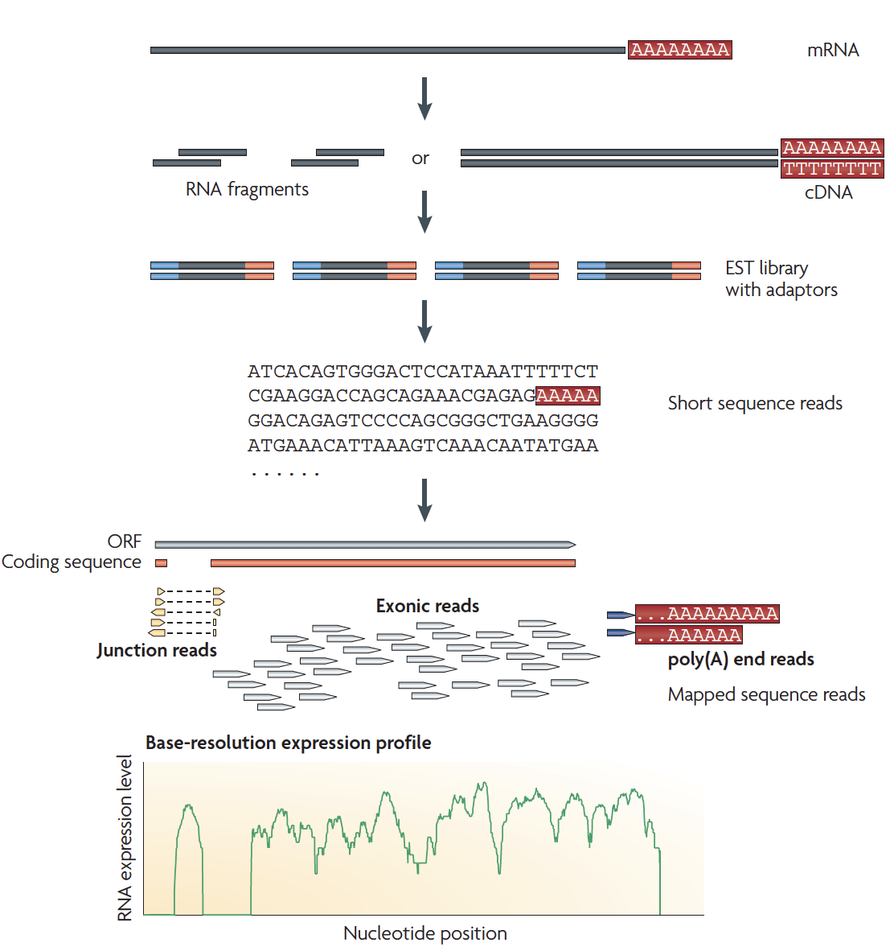
Typical RNAseq experiment
Wang et. al. Nature Review Genetics 2009

Slide 4
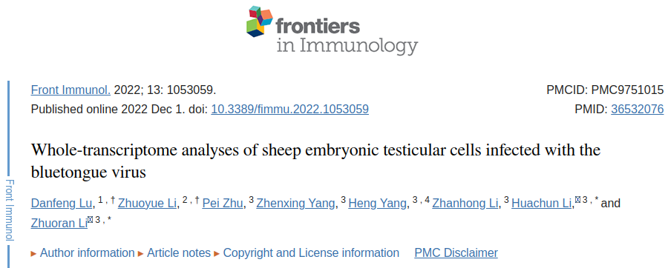
RNAseq data from GEO (ID: GSE213637)
Dataset was downloaded from SRA website using given SRA identifiers
Normal Samples | Viral-infected Samples
SRR21623193 | SRR21623196
SRR21623194 | SRR21623197
SRR21623195 | SRR21623198
URL: https://www.ncbi.nlm.nih.gov/geo/query/acc.cgi?acc=GSE213637

Slide 5
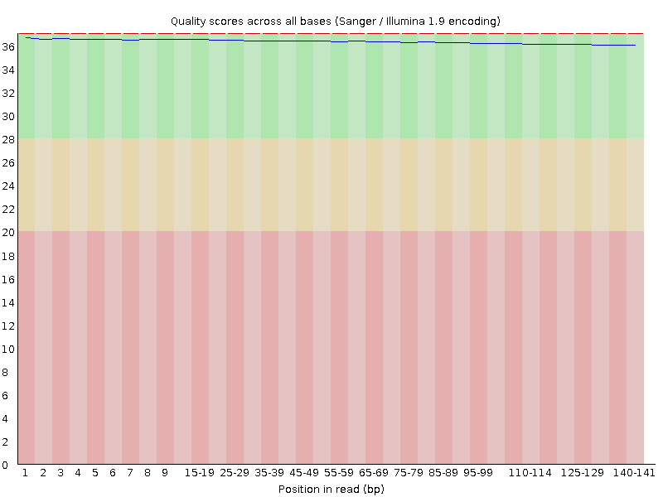
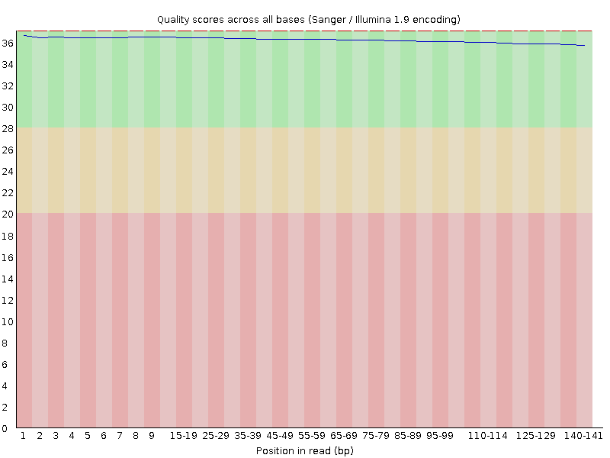




Sequencing data quality- FastQC analysis
SRR21623193 FR
SRR21623193 RR
SRR21623194 FR
SRR21623194 RR
Quality Score
SRR21623195 FR
SRR21623195 RR
Position in read (bp)

Slide 6





Sequencing data quality- FASTQC analysis
SRR21623196 FR
SRR21623196 RR
SRR21623197 FR
SRR21623197 RR
Quality Score
SRR21623198 FR
SRR21623198 RR
Position in read (bp)

Slide 7
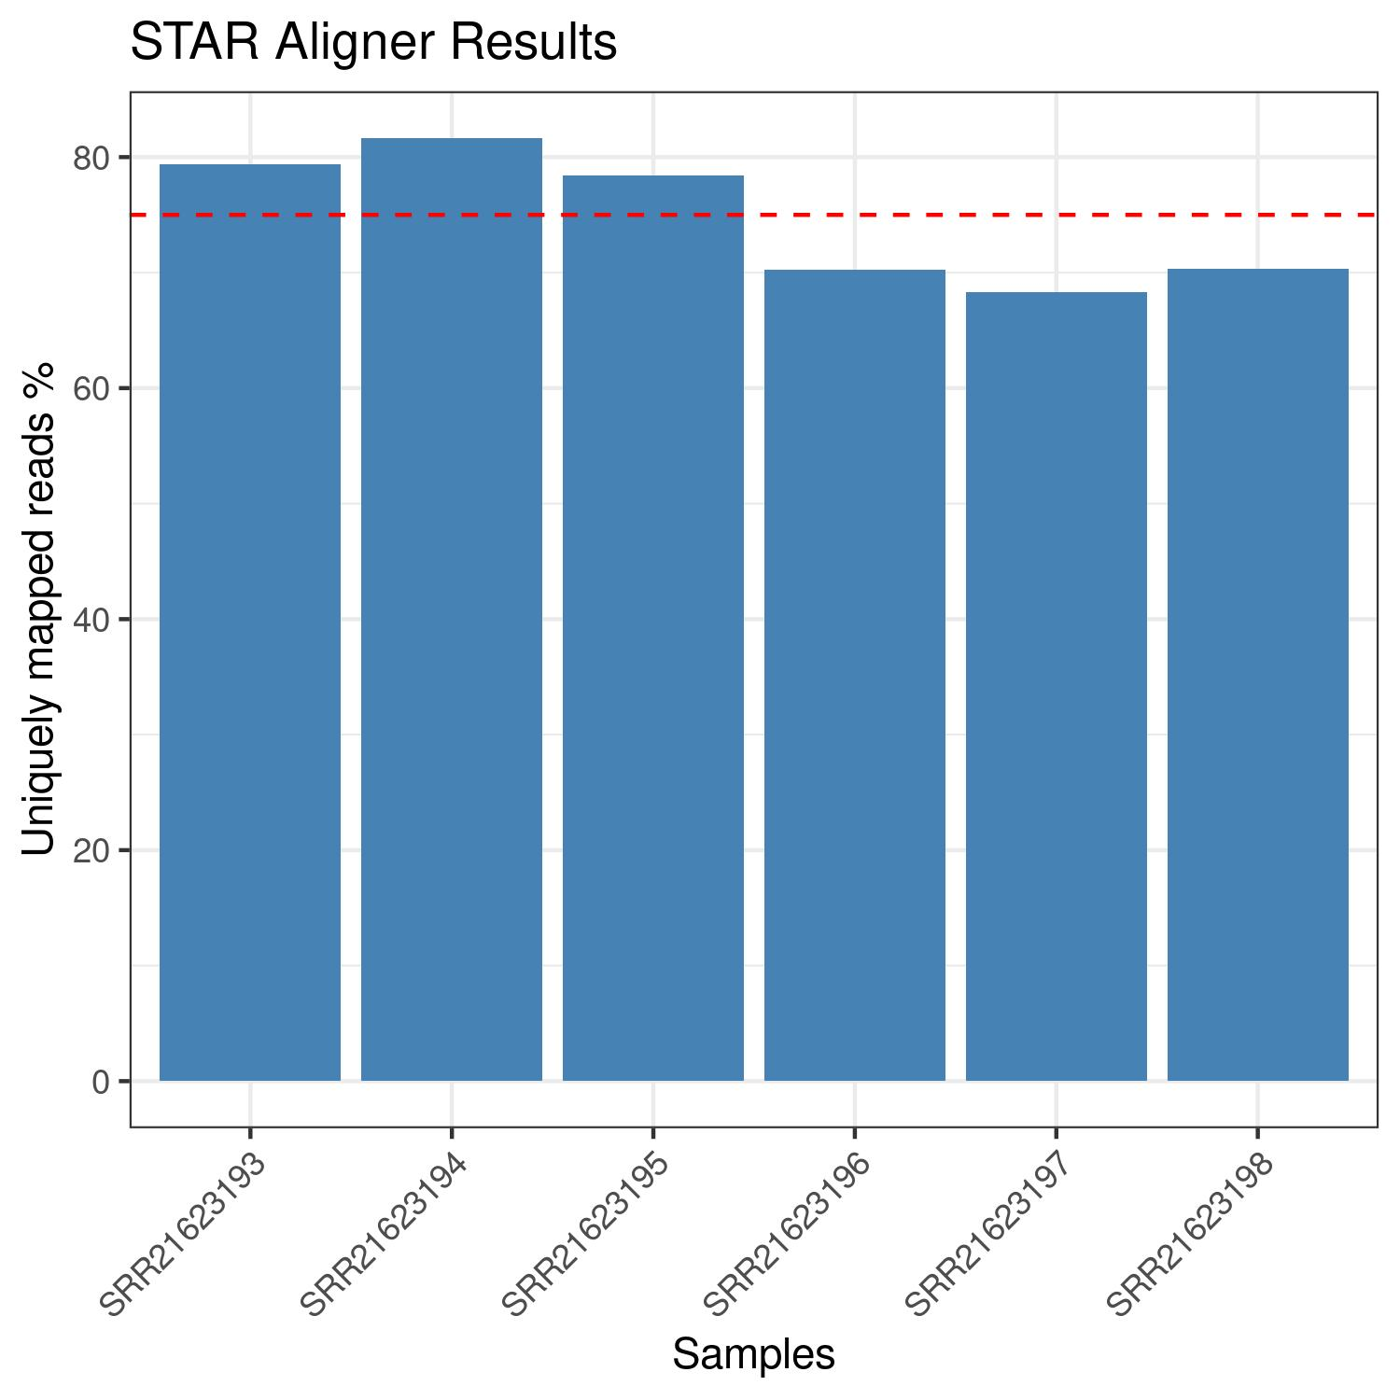
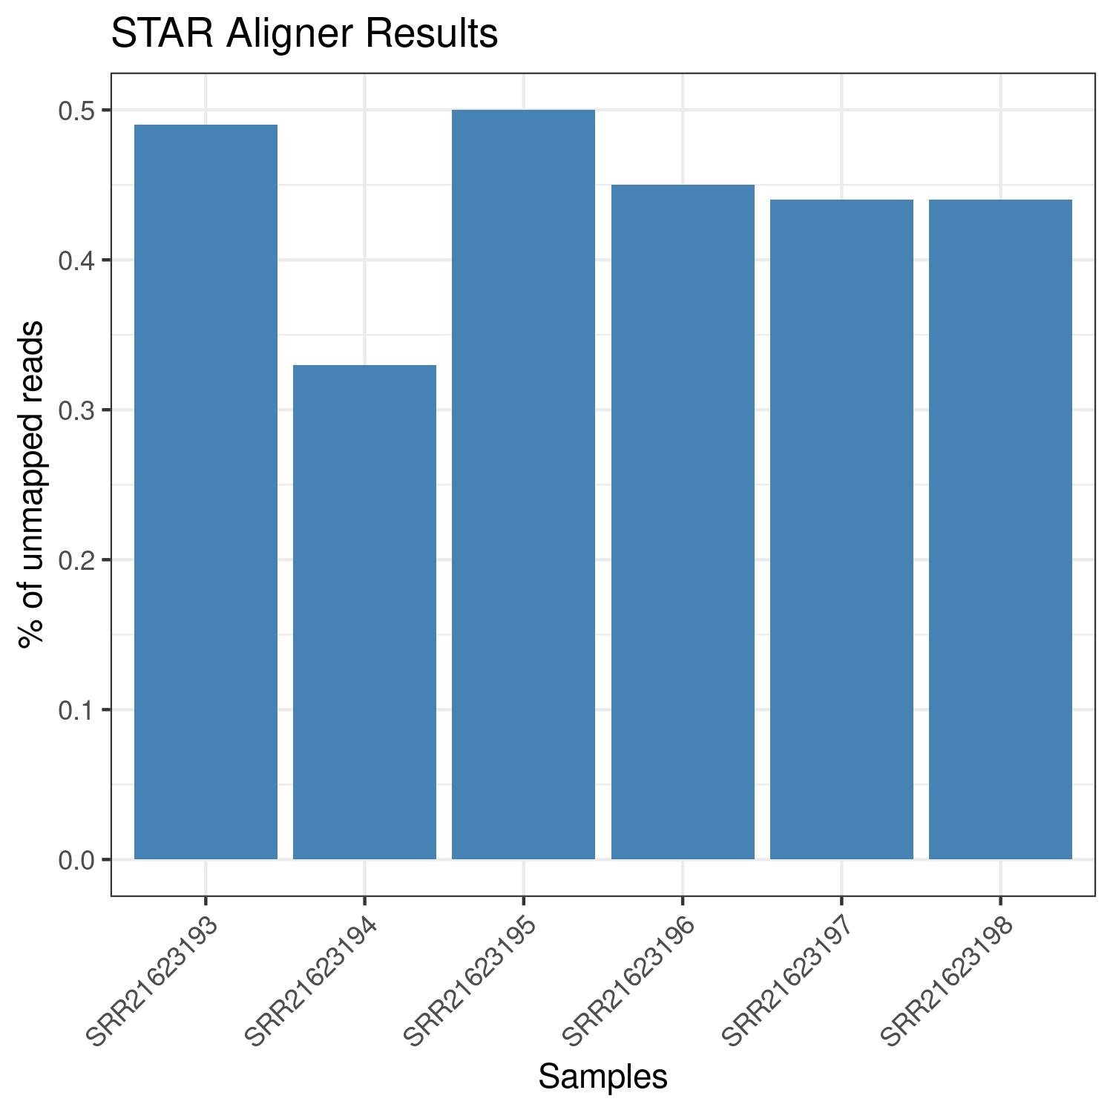
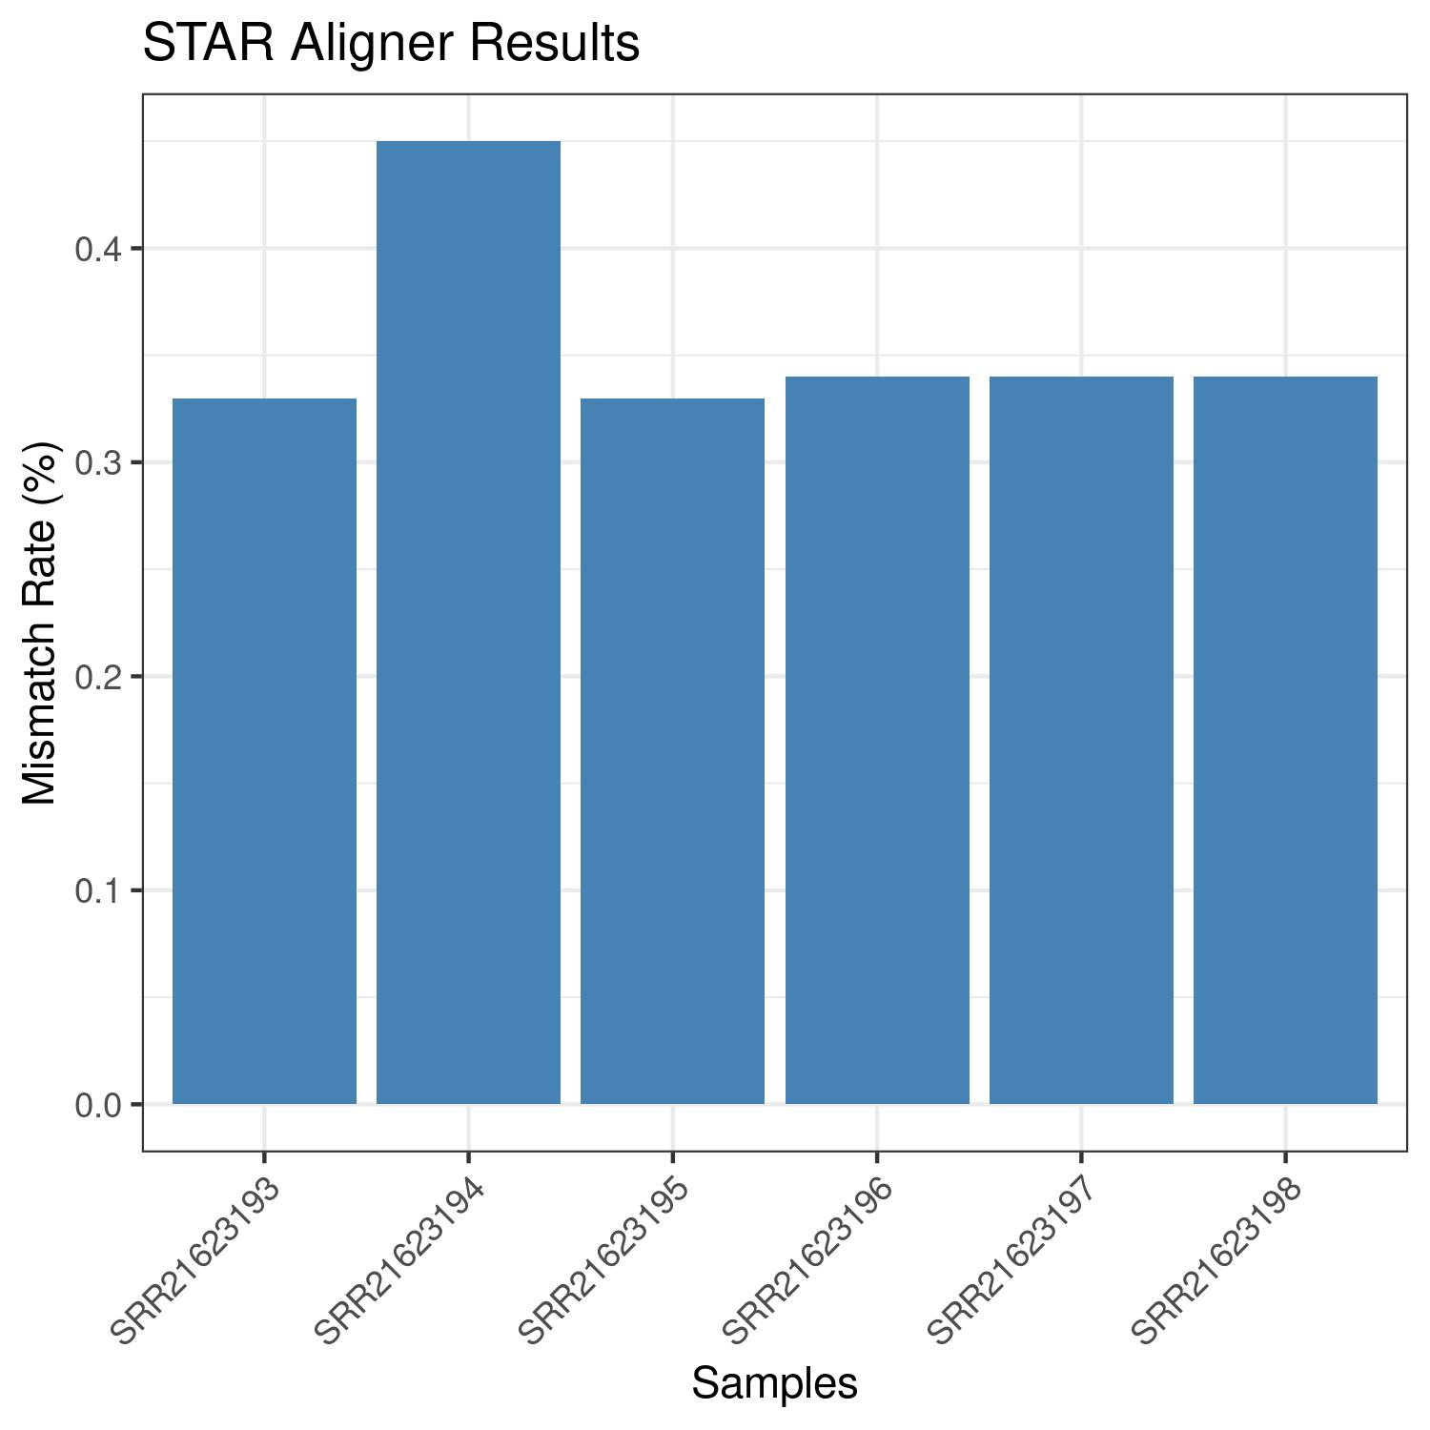
STAR Alignment Quality
Uniquely mapped reads
% of unmapped reads
Mismatch rate

Slide 8
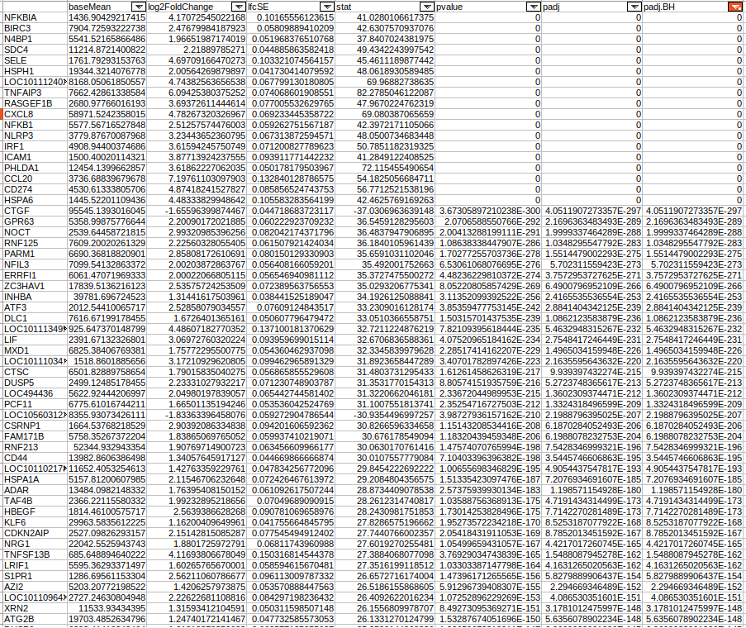
Results- DESeq2
7442 genes were found significantly differentially expressed between untreated and treated samples.
Criteria used to define DEG: padj.BH < 0.01 and log2 fold change >= 1 or <= -1

Slide 9
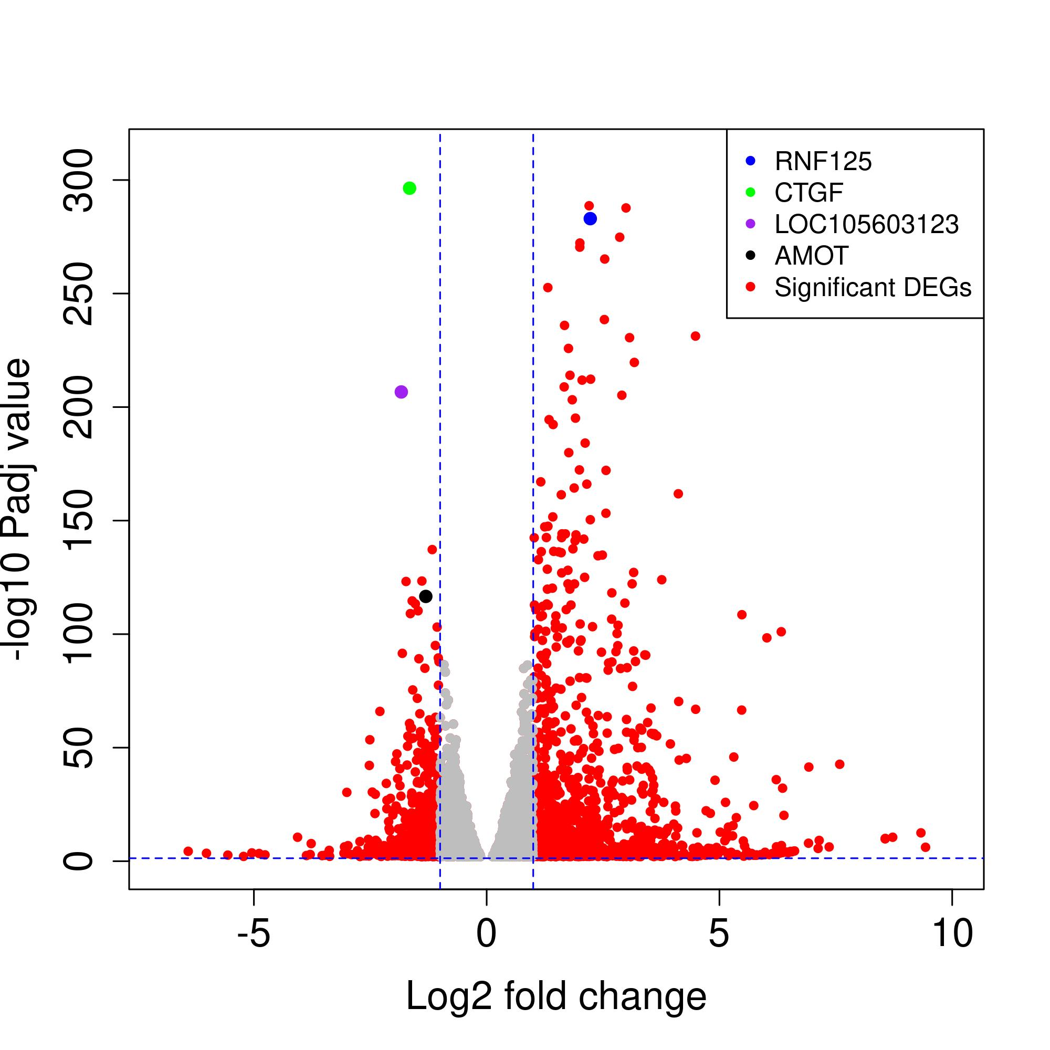
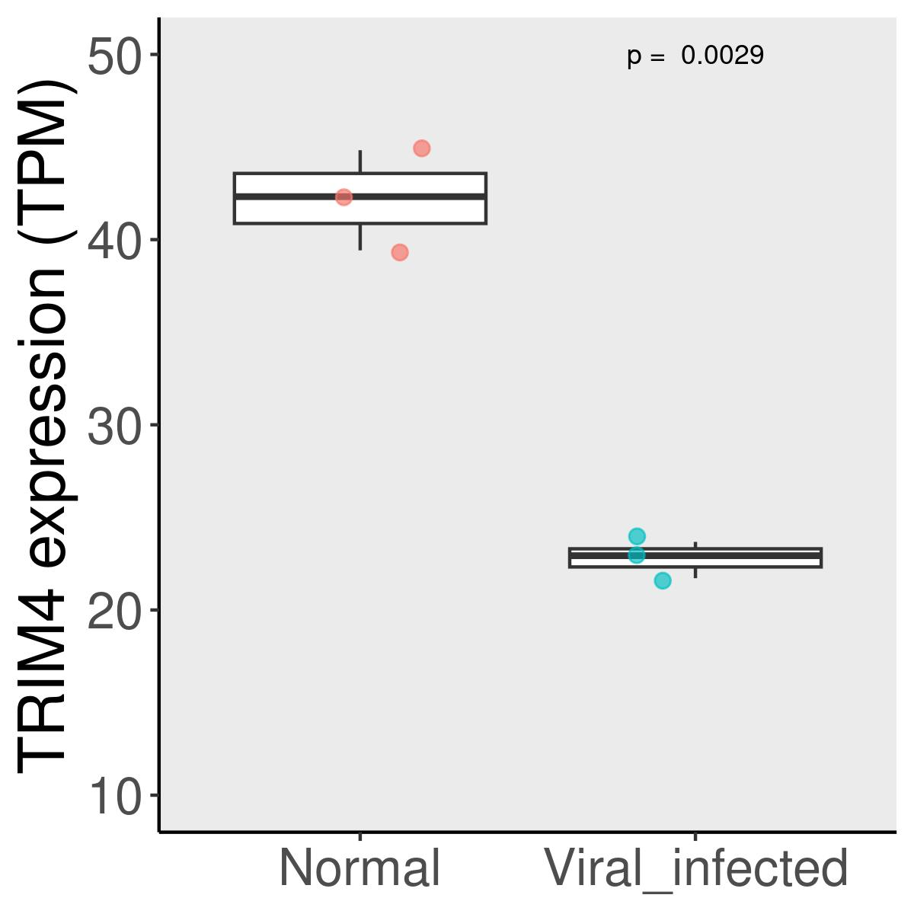
Volcano plot showing the distribution of
adjusted P value and log2 fold change
TRIM4 expression in normal and viral-infected samples

Slide 10
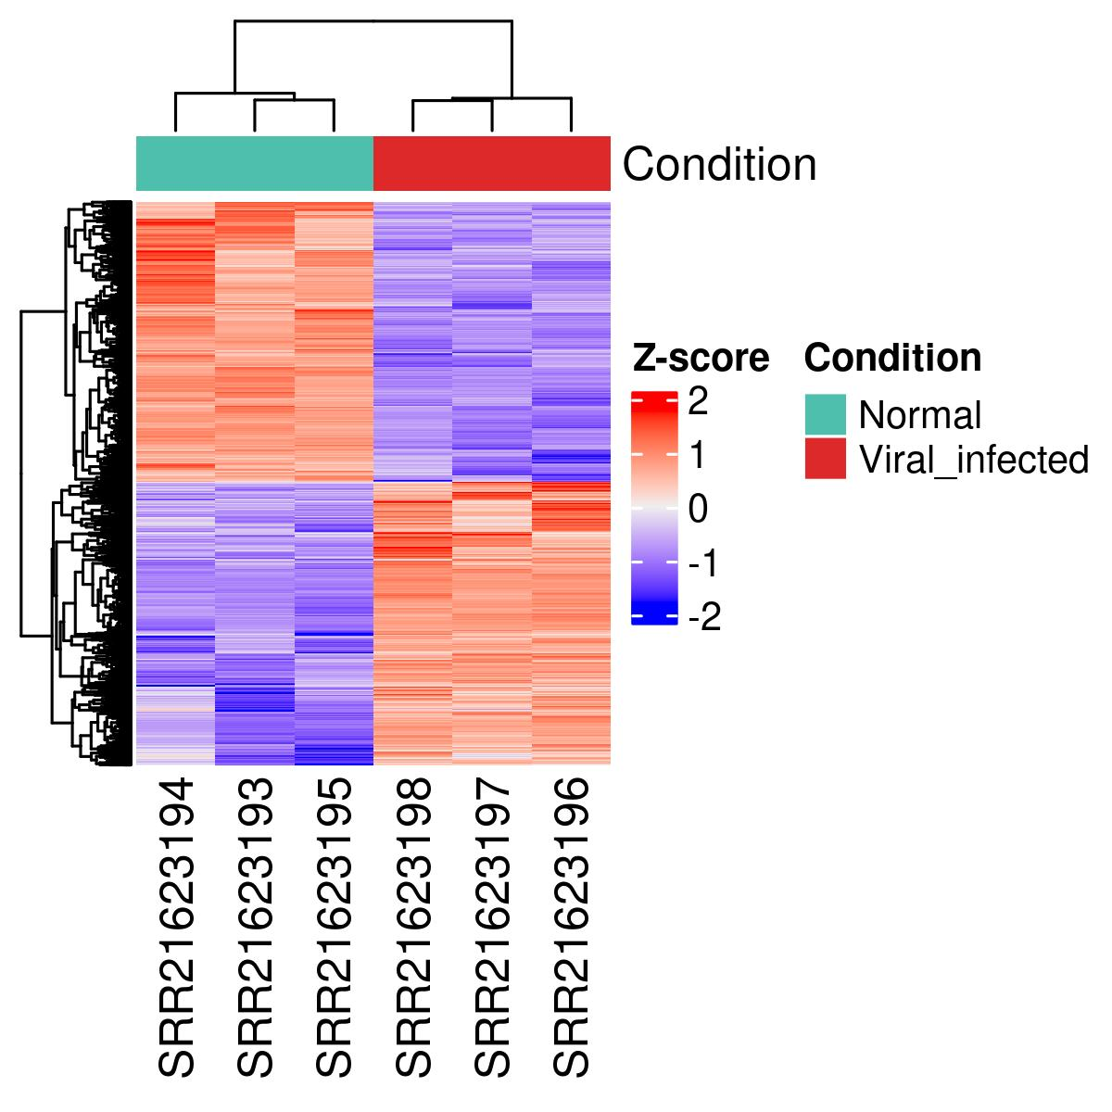
Heatmap showing the expression of significantly
DEGs (n=7442) in normal and viral-infected samples

Slide 11
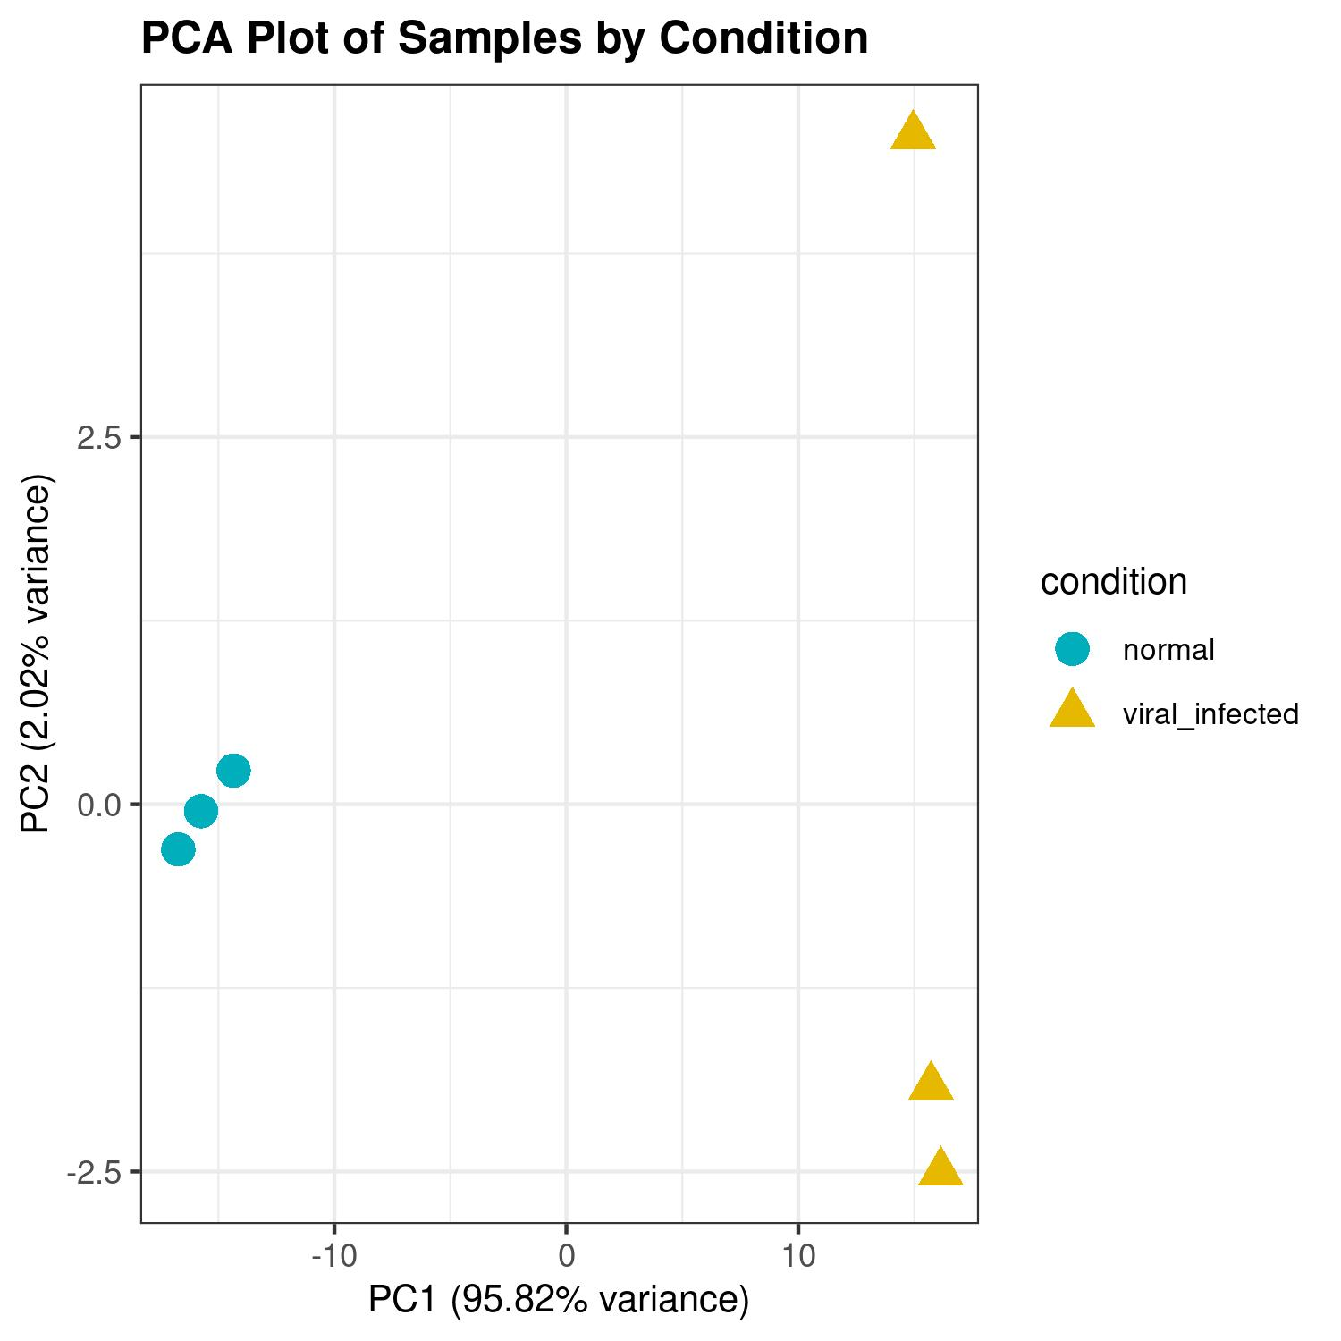
Principal component analysis using significant DEGs

Slide 12
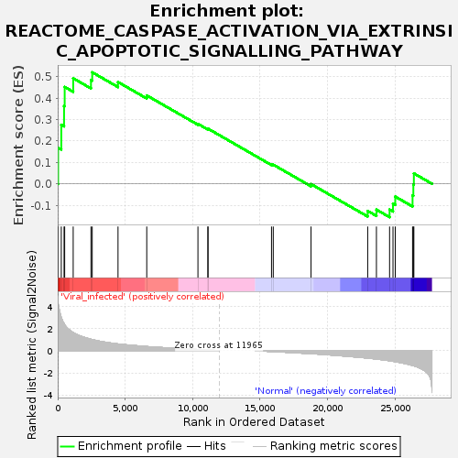
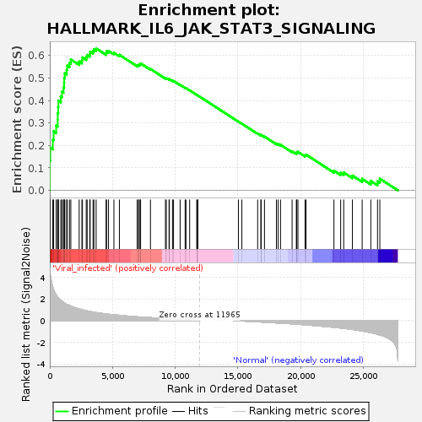
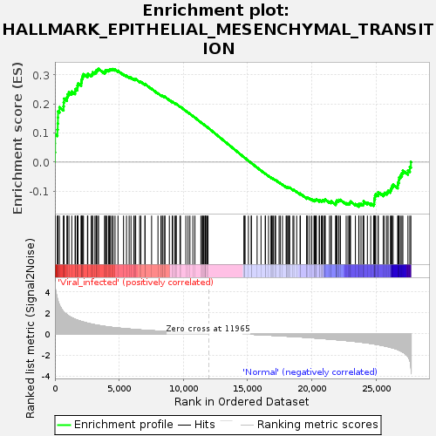
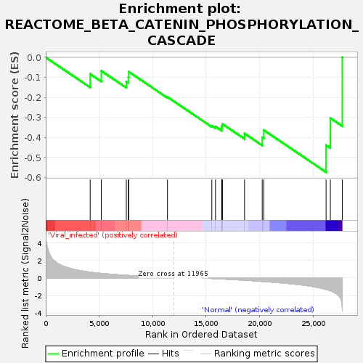
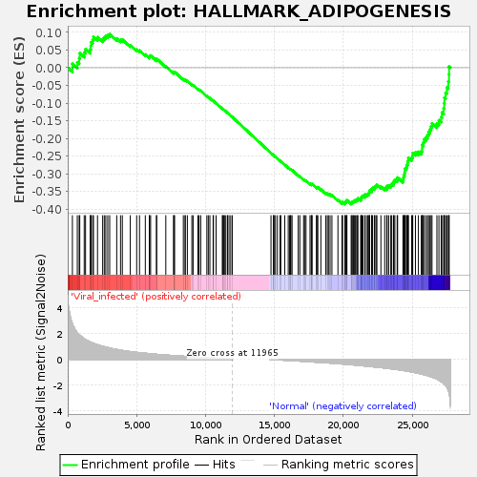
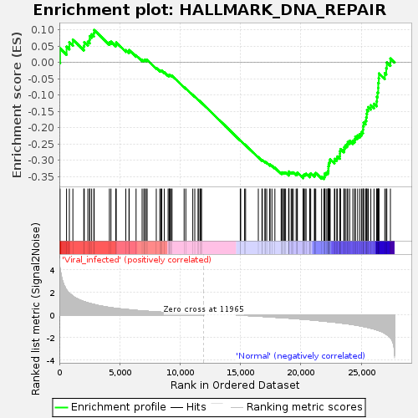
GSEA Analysis

Slide 13
STRING Analysis
Protein-Protein networks
visualization

Slide 14
STRING Analysis
A closer look at the specified region

Slide 15
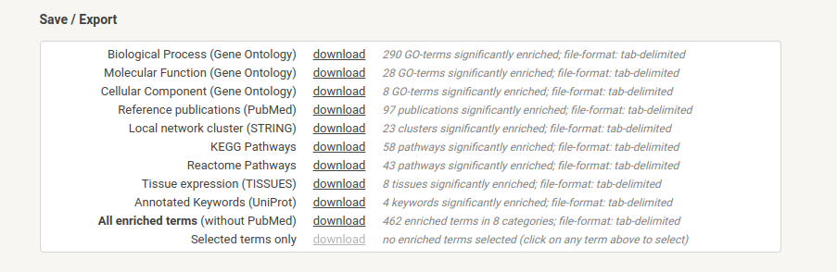
STRING Analysis
The users can also view and download the various enrichment pathways for the specific species (Ovis aries) from STRING database

Slide 16
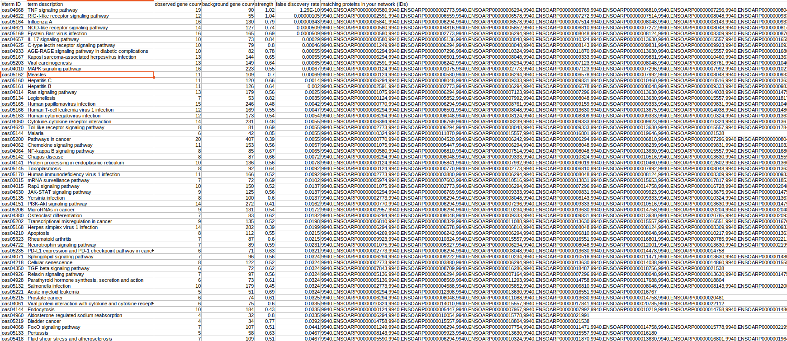
STRING Analysis- Pathway Enrichment analysis

Slide 17
Summary
Normal samples fastqs
Viral-infected samples
fastqs
STAR aligner
BAM files
featureCounts
Gene Counts
Differential Gene Expression (DGE) analysis using DESeq2
GSEA
STRING
analysis

Slide 18
Software download links:
FastQC: https://www.bioinformatics.babraham.ac.uk/projects/fastqc/
STAR: https://github.com/alexdobin/STAR
featureCounts: http://subread.sourceforge.net/
DESeq2: https://bioconductor.org/packages/release/bioc/html/DESeq2.html
GSEA: https://www.gsea-msigdb.org/gsea/index.jsp
STRING: https://string-db.org/

Slide 19
Thank You!

Slide 20
GSEA Methodology
GSEA software download
Loaded the phenotype.cls and tpm_counts.gct files
Loaded the phenotype.cls and tpm_counts.gct files
Gene_sets_database="Reactome",
No_collapse
Results

Slide 21
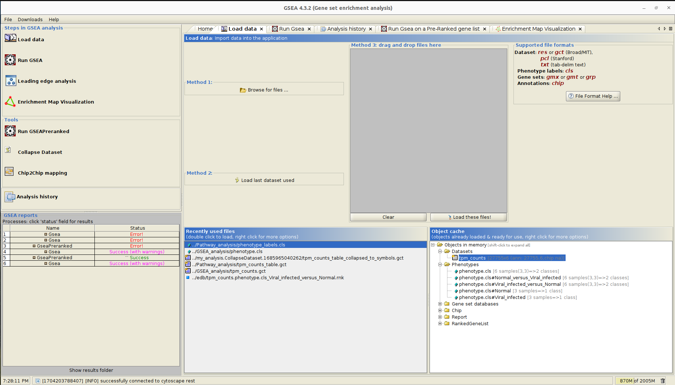
GSEA GUI

